Slide 1
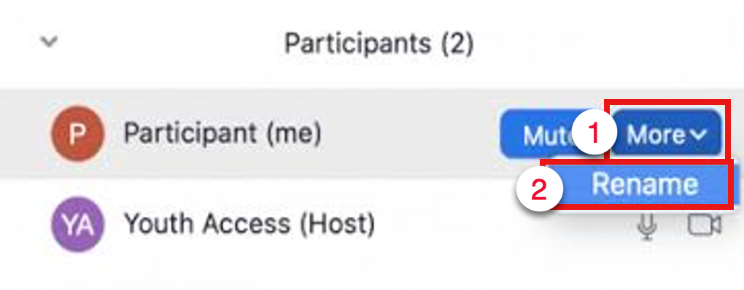
Zoom Essentials
Music by: Chris Haugen Pure Magic
Welcome! We will start at 2 minutes past the hour
Before session starts, click to open Participants window. Rename yourself to include your pronouns and preferred name.
Click and type a response to:
Technology Enhanced Education Team
What course(s) or block(s) in the Bridges Curriculum are you involved with?
Notes:
About this training:
See it: Live demo in Zoom
Watch it: Show video clip if time permits
Hear it: Just talk about it
Try it: Talk about or demo it, then allow learners to practice it
Chat it: Ask participants to respond using Zoom chat
Annotate it: Ask participants to respond using Zoom annotation
Poll it: Ask participants to complete a poll
Before you start:
Make sure you are host
Share desiktop and computer sound
Make sure that in your "Share Screen" settings, “Show Zoom windows during screen share" is eabled
Play 2-minute music before starting

Slide 2
Part 1 Intro

Slide 3
Meet Your TEE Facilitator
Sam Chung’s hobbies: Personal finance, movies, podcasts, and the news
Notes:
Hide if needed

Slide 4
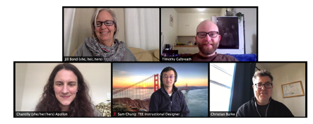
About this session
This session is for beginning and experienced users teaching in or supporting Bridges curriculum
We recommend hands-on self-practice afterwards
TEE also offers a workshop on Zoom Polls and Breakouts

Slide 5
Session norms
Showing your video is optional
Please jump in anytime with questions (audio or chat)
We will moderate chat: Preface questions with a ?
Example: ? Can you share an example of that concept?
If you don’t want to be called on, add X in front of your name

Slide 6
Session learning goals
Prepare for meeting
Manage meeting roles
Use polls
Humanize your session
Share content

Slide 7
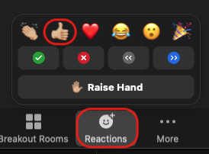
Download session files (Try it! )
Click Chat
Click link in chat & download PPTX file: http://tiny.ucsf.edu/ze
If you can’t click the chat link, update Zoom app later
After downloading, click Reactions, then click Thumbs up
Notes:
Paste into chat: http://tiny.ucsf.edu/ze
Ask if anyone had difficulty downloading the files
Let them know verbally if they can't click a link or see these same reactions, they need to update their app after this session.

Slide 8
Part 2 Prepare for meeting

Slide 9
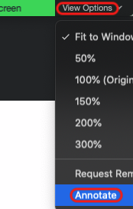
Identify 1 action that will not improve your Zoom Internet connection (Annotate it! )
 | Sample answer choice
 | Move computer closer to your wireless router
 | Ask others nearby to stop using Internet
 | Leave the meeting and immediately re-join
 | Ask someone else to Share Screen instead
 | Switch from computer audio to phone audio
 | Stop your Webcam video
 | Select a stronger wireless network connection
Notes:
Tell them how to annotate the current slide (see screenshot on left).
Mention the “Sample answer choice”.
Correct answer: Leave the meeting and immediately re-join

Slide 10
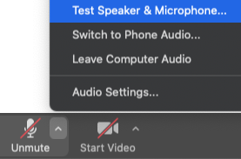
Switch audio device (See it! )
If audio doesn’t work, click upward-arrow next to (Un)mute button
Choose a speaker and microphone
Or click Test Speaker & Microphone
Check out this audio device guide
If audio still doesn’t work:
Click Leave Computer Audio
Then click Switch to Phone Audio
Notes:
Wired earbuds & headphones don’t need charging but don’t look as good as wireless devices.
Bluetooth can lose connection or lose audio quality due to interference.

Slide 11
Part 3 Manage meeting roles
Notes:
If time permits, stop for questions

Slide 12
Describe the host role (See it! )
There can only be one host in each meeting
The host can promote participants to co-host, or transfer host role
Hover cursor over a participant's name
Click More to Make Host or Make Co-host
Host has all meeting controls, co-host has most controls
Only hosts can end a meeting
But no one can host breakout rooms on a mobile device—use a computer

Slide 13
Join Bridges class session as host (Watch it! )
Watch this video or follow steps below
If you don’t follow steps, you might enter session as participant
Log in to MyAccess
If you don’t see Zoom in the list of apps, click Manage Favorites
Click Zoom, then click LOGIN in the upper-right
Start your meeting via the Zoom site or click an Outlook meeting link
Notes:
If you show 1.5 minute video, you don’t need to talk through steps in the slide

Slide 14
Part 4 Use polls

Slide 15
Create Zoom polls (Hear it! )
Only 2 question types: single choice, multiple choice
You can only create & edit polls for meetings created using your own Zoom account
Hosts & co-hosts can launch polls

Slide 16
Use Bridges default polls (See it! )
Practice recommended
For classes in the Bridges curriculum, create poll slides
State the poll question
Provide answer choices A – E or True/False
Default poll types:
Multiple Choice - One Answer
Multiple Choice - more than one answer
True-False
During the Zoom meeting, click
Use the drop-down menu to select the poll, then click
Notes:
This can also be a “Hear it!”

Slide 17
Default poll slide template (Multiple Choice - One Answer)
QUESTION HERE? (Choose 1)
Answer choice
Answer choice
Answer choice
Answer choice
Answer choice
Notes:
Use the Zoom poll.
Alternative is to use PollEverywhere online.

Slide 18
Which 1 of the following Zoom tools is the best alternative to polling? (Poll it! )
Reactions
Chat
Video
Audio
Annotation
Notes:
Run Zoom default poll
There is no right answer

Slide 19
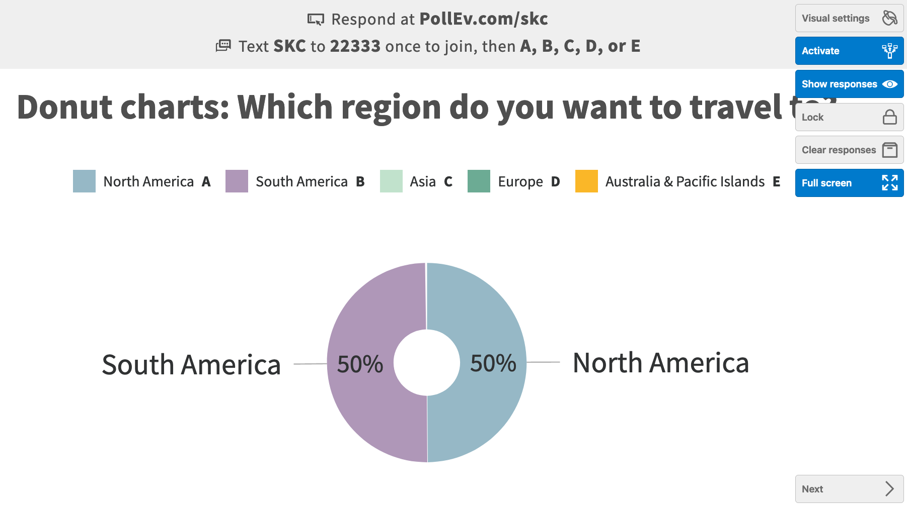
Run Poll Everywhere polls (Hear it! )
Practice recommended
Log in to MyAccess to access Poll Everywhere
In Zoom, click Share Screen and share your entire desktop
Run polls from the Poll Everywhere Web site if necessary

Slide 20
Notes:
This is session half-way point

Slide 21
Part 5 Humanize your session

Slide 22
Humanize your Zoom session (Hear it! )
Show empathy for the learner​ by focusing on their needs and experiences
Nurture connection, equity, and inclusion among learners and faculty​
Created by Loka Mariella from Noun Project
Notes:
Use reactions - thumbs up – Who feels connected with their colleagues in Zoom sessions?
Next let’s try out one strategy – the Raise Hand technique here to ask a Q. I’m going to ask you a Q and please use the “raise hand” feature when you think of an answer. Please don’t use audio--wait to be called on.

Slide 23
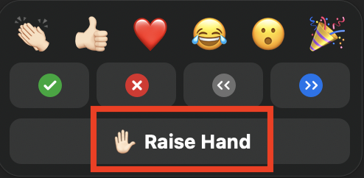
What are some techniques you’ve noticed in this session that create a more connected and inclusive experience?
In Reactions, click Raise Hand
Notes:
Explain the “wait time” approach –I am going to ask the question, wait for 3 learners to “raise” hands, then take responses, after 3 share out, then open discussion to the group.
Explain where to find raise hand feature. Once called upon, you can use your audio and turn on your video, if you prefer. Remind them to lower their hand. Call on next person. Check chat just in case.
Question:
Thinking about creating equity and inclusion, what are some techniques you’ve noticed in this session that might have created a more human experience? Let people use chat if there are no hands up.
Answers:
Intro slide has music + activity to break ice while waiting for the session to begin
Facilitator personal intro slide
Setting norms
Video optional
New ways to call on people – could also ask Q, tell people to type answer in chat but WAIT to hit enter and then prompt all to hit enter at same time, review answers together.
Polling
Annotation
Using reactions
Using chat
Long pauses
Check ins - I’d like to pause here and hold this moment for anyone else who would like to share.​
Didn’t demo today but you can use collaborative spaces:​ breakout rooms, whiteboard,​ cloud documents​

Slide 24
Part 6 Share content

Slide 25
Share content (Watch it! )
This video will show you how to share:
Computer sound
PowerPoint full screen
Portion of your screen

Slide 26
Part 7 Closing remarks

Slide 27
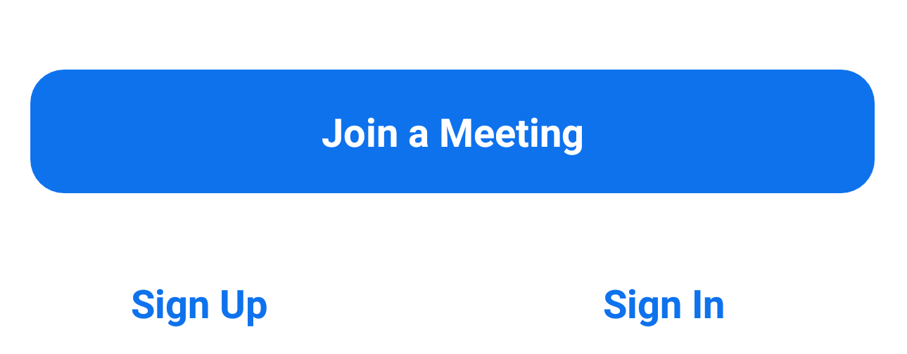
Practice Zoom (Hear it! )
Practice recommended
Practice Zoom tools with colleagues and TAs
Join your own practice meeting using second device or computer
Rehearse your presentation using Zoom, especially if complex
Ask participants if they’re hearing & seeing what you’re sharing

Slide 28
Practice sharing in breakout room (Hear it! )
Make sure you have these slides: http://tiny.ucsf.edu/ze
Take turns sharing your computer sound, full screen, or part of screen
Or practice anything else you learned today
Click Breakout Rooms, then click when you have questions
Or Leave your Breakout Room when you have questions
This optional video will show you how to:
Prepare breakout rooms
Manage breakout rooms

Slide 29
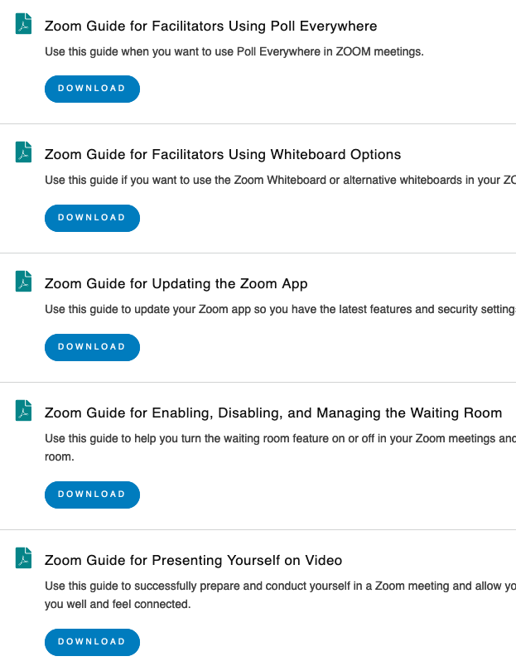
Helpful UCSF Zoom Resources
TEE Zoom Guides
TEE Remote Learning Toolkit
Library’s Zoom site
IT’s Zoom site
ETS’s Zoom site
TEE Poll Everywhere site
Notes:
Examples in image are from TEE Zoom Guides site

Slide 30
Please help us improve this workshop
Zoom Essentials
http://tiny.ucsf.edu/f
Notes:
Paste into chat: http://tiny.ucsf.edu/s1

Slide 31
Q&A
Covered in Zoom Essentials
Prepare for meeting
Manage meeting roles
Use polls
Humanize your session
Share content

