Slide 1
Welcome!
Strategies for Facilitating Remote Small Groups
1. Please note that a symbol has been (or will be) added to your name to help us with facilitation.
2. While we are waiting to begin, please reflect on your most memorable or significant educational experience?
Who was involved?
How did you feel?
What made it memorable or significant?
Notes:
Facilitator – begin adding symbols to names
Checkin with a thumbs up before beginning

Slide 2
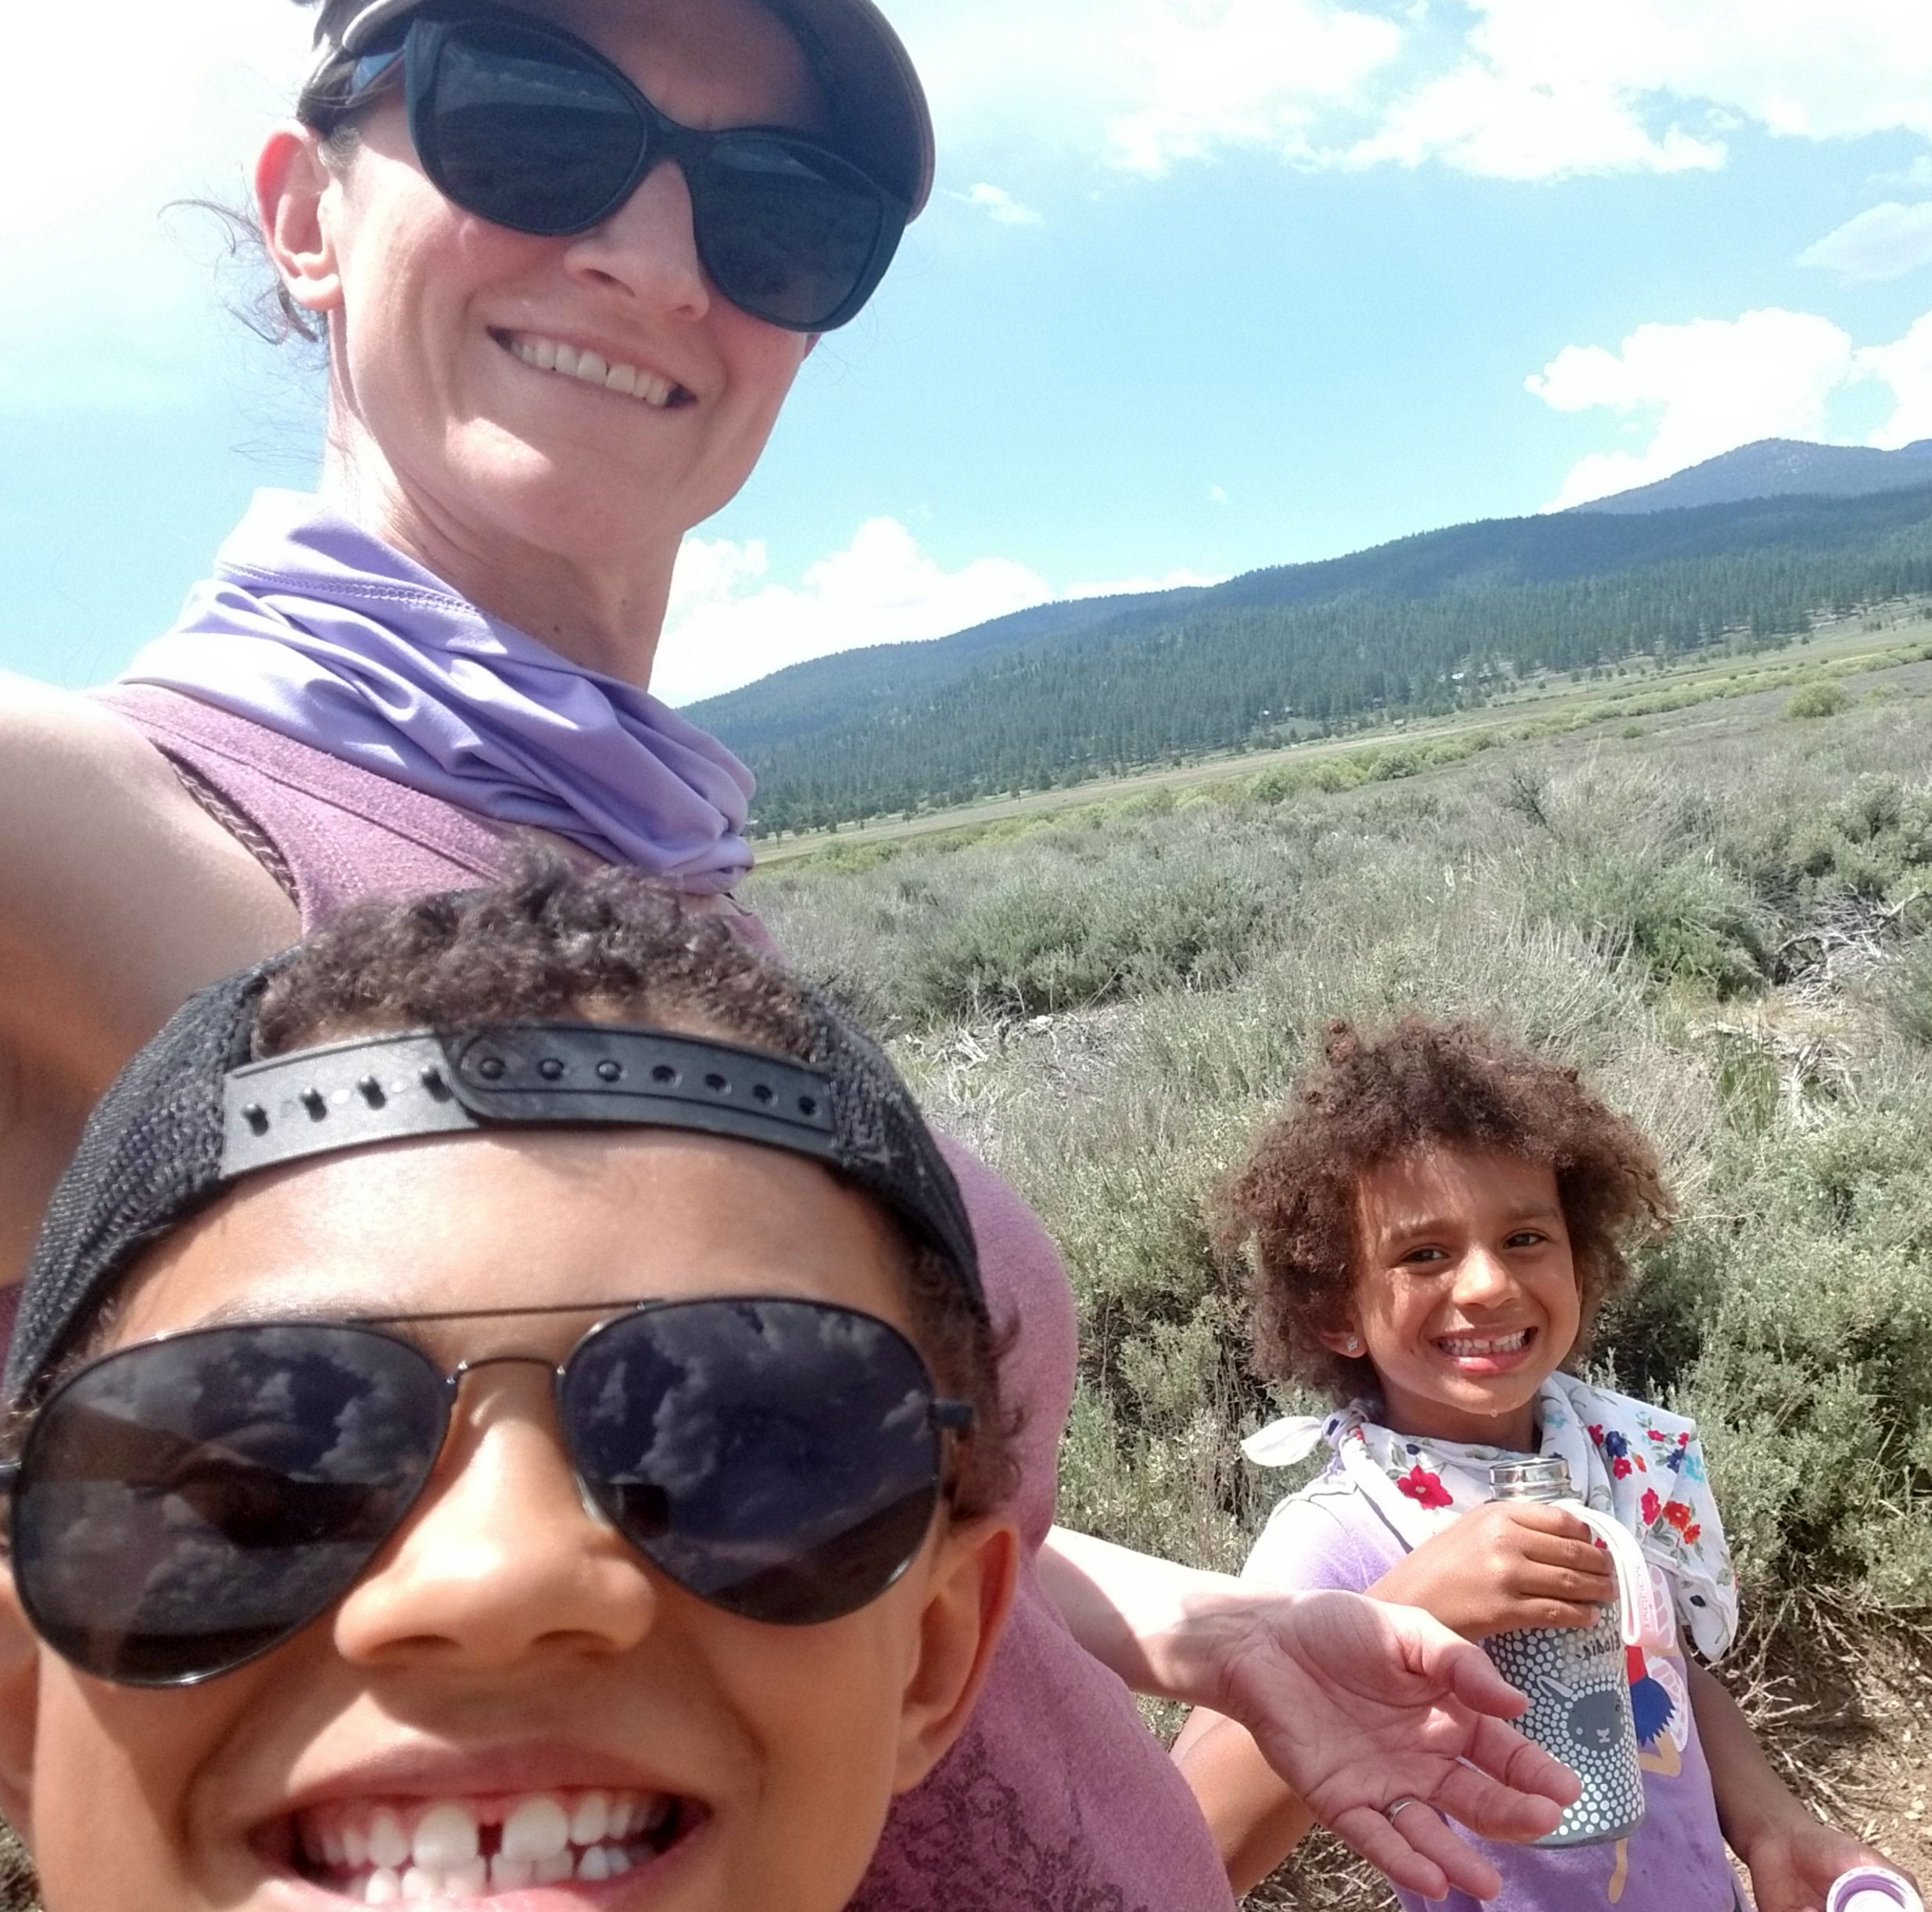
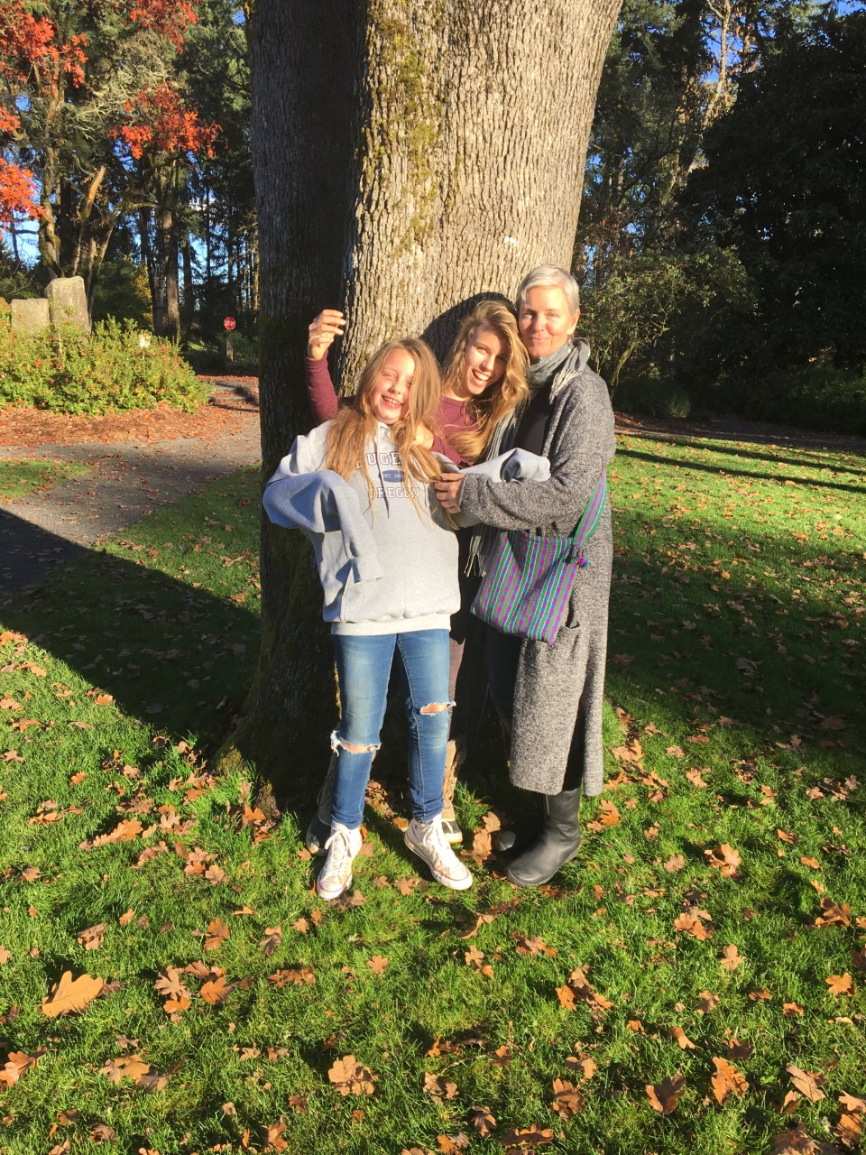
Your Facilitators
Norms
Rename yourself as you wish to be called on
Include pronouns
Video on/off as preferred
Public or Private Chat to Jill Bond
If you are not able to engage through audio/video add an X in front of your name
Participate & Engage in any way that works for you!
FYI: Recording will begin now!
Chantilly (she/her)
Fitness Fanatic,
learning Ukulele
Jill (she/her)
Enjoys puzzles, podcasts,
and urban hiking
Notes:
Add norms to this slide.
Make sure that you set the stage – many techniques
This workshop gives you many ideas for engaging with learners

Slide 3
Breakout Room
Random Pairs
Brief introduction
  Name and Role at UCSF
Share your most memorable or significant educational experience
Please stay in the room until it closes
5 minutes
Notes:
Brief introduction: Name and UCSF role
Share your most memorable educational experience
Please stay in the room until it closes.
5 minutes total

Slide 4
Zoom Annotation
Laptop/desktop
View Options
Annotate
Stamps
Mobile Device
Bottom left of screen
Pencil icon

Slide 5
What made the learning experience memorable/significant?
The instructor/faculty member | Comfortable environment | Topic interested me | "Aha" moment of understanding
Working with peers | Had fun | Feeling of accomplishment | Learned from a mistake
Gained confidence | Produced something I was proud of | Felt like the instructor knew me/cared about me as a person | Emotional experience
Notes:
We won't create the most significant or memorable experience each time we teach, but we can aim to pull from those experiences and incorporate best practices that engage as many students as possible and create a positive learning environment where students feel comfortable

Slide 6
Learning Objectives
1
Utilize technology tools to promote active learning, engagement, and equity.
2
Develop facilitation skills to align learning objectives with technology tools and best practices.
*Please note that a symbol has been added to your name to help us with facilitation.
Notes:
A gentle reminder that this workshop is how to use tools of Zoom, Zoom essentials is a great introduction to the tools
sort of at the application level of Bloom’s taxonomy…

Slide 7
How confident are you in your ability to facilitate an engaging virtual small group learning experience?
Very Confident
Moderately Confident
Somewhat Confident
Slightly Confident
Not At All Confident

Slide 8


Pause
Questions & Reflection
Chat Check-in
Respond to this reflection in chat:
  What tools or techniques have been used so far (in this workshop) to promote active learning, engagement, and equity?
Notes:
Group Notes Document – scribe in another document!

Slide 9
Poll Everywhere
In this 5-minute activity, you are going to use a student response system to explore a model for how group behavior changes.
Poll Everywhere
  Look for link in chat
  1-minute to respond on your own
    Place the stages of group development in order (first on top and last on the bottom)
Notes:
We are going to continue with additional engagement techniques that also serve the purpose of bringing in additional content
Be sure to transition individuals from one activity to the next
https://pollev.com/chantillyucsf

Slide 10
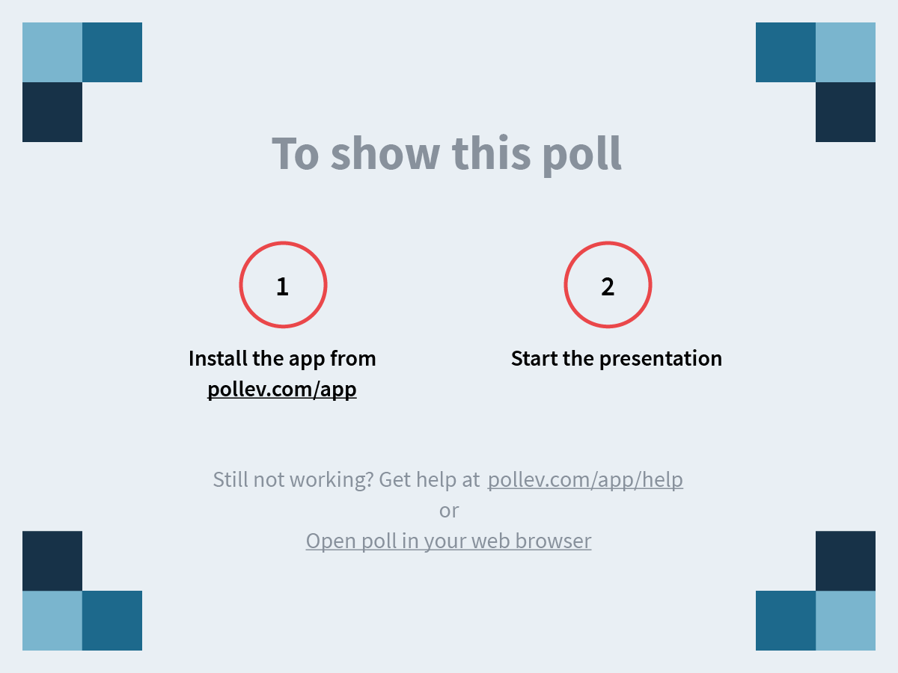
Notes:
Group Behavior: Put the following stages in order of how groups
https://www.polleverywhere.com/ranking_polls/t5gNhK1GSPvsXGN33y3VF
Show the responses (and check carefully the order!)

Slide 11
Bruce Tuckman’s Model of Group Behavior
Forming
Storming
Norming
Performing
Adjourning
Respond to this question by typing into chat
  Which stage leads to learning (content)?
Notes:
People respond in chat to both questions (animate appearance)
Graphic Design (Jill plans to put the Model into a box for appearance and color)

Slide 12
Pause |Questions & Reflection
Chat Check-in
Reflections or take-aways at this point?
Notes:
Group Notes Document – scribe in another document!

Slide 13
Breakout Rooms
Zoom creates the "rooms"
What activities could your learners do in the breakout rooms?
How could you ensure the activity works well?
Notes:
You have
Invite annotating with text!

Slide 14
Part A
  You will be placed in a breakout room with 2-3 other people
  Link to folder in chat: https://tinyurl.com/ZoomJigsaw
  Open the document that corresponds to your Breakout Room Number
  Work through the instructions and activity with your group.
  The person that went to bed the latest will share their screen and scribe
Notes:
Groups get 8 minutes to brainstorm and formulate a way to communicate with others about their brain storm

Slide 15
Group Behavior Check-in
Forming
Storming
Norming
Performing
Adjourning
Zoom Poll
  How many minutes did it take to get to Performing?
    A. 1
    B. 2
    C. 3
    D. 4
    E. 5+

Slide 16
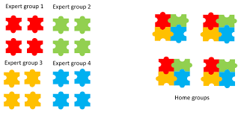
Part A
Part B
$
$
#
#
$
#
$
#
*
@
*
Jigsaw Diagram
$
$
#
#
$
#
$
#
*
*
@
@
*
@
*
@
*
*
@
@
Notes:
Strategy versus technology

Slide 17
Jigsaw
Part B
Share your symbol group’s ideas with others
New Breakout Room with different people
The person who went to bed the earliest yesterday is the group’s timer
Each person summarizes the ideas and discussion from Part A
~2 minutes per person

Slide 18
Pause |Questions & Reflection
Take-aways from the Jigsaw?
Technology & Chat Check-in
Notes:
Group Notes Document – scribe in another document!

Slide 19
How confident are you in your ability to facilitate an engaging virtual small group learning experience?
Very Confident
Moderately Confident
Somewhat Confident
Slightly Confident
Not At All Confident

Slide 20
What will you be using?
Chat | Renaming to help facilitation/ groupings | Chat moderators | Zoom Polls
Poll Everywhere | Zoom Annotation | Breakout Rooms | Collaborative Documents
Practice | Nonverbal responses | Reactions (Emojis) | Clear Instructions
Other: Use Text annotation to write in your responses

Slide 21
Wrap up
Qualtrics Evaluation of this workshop

