Slide 1
Collaborating Virtually:
Annotating, Whiteboarding, & Managing Screen Space
Answer in chat….which one are you?

Slide 2
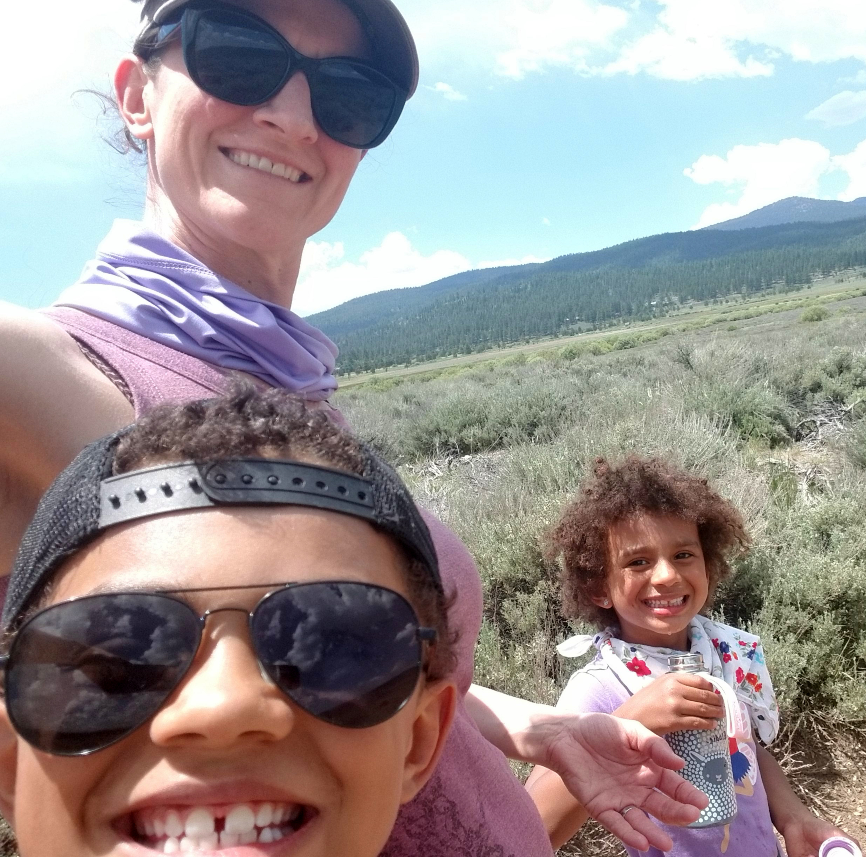
Your Facilitators & Norms
Rename yourself and include pronouns
Video on/off
Public or Private Chat to Jill Bond
If you do not wish to be called on, add an X in front of your name
Participate & Engage with us!
Chantilly Apollon
Jill Bond

Slide 3
On the next slide, is a prompt.
To respond, please use Stamps available in the annotation tools

Slide 4
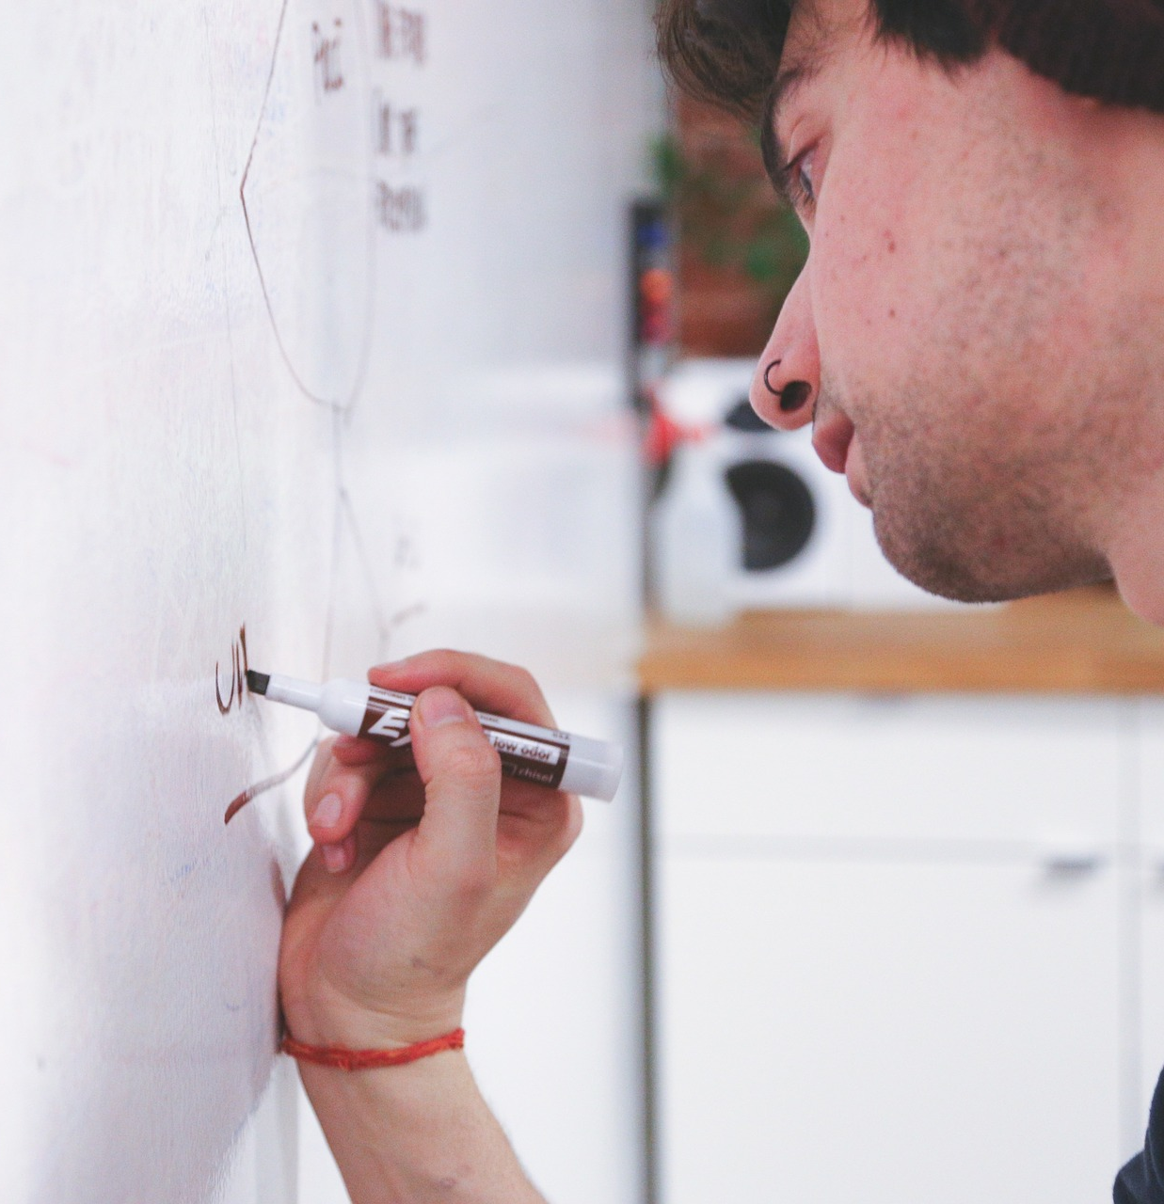
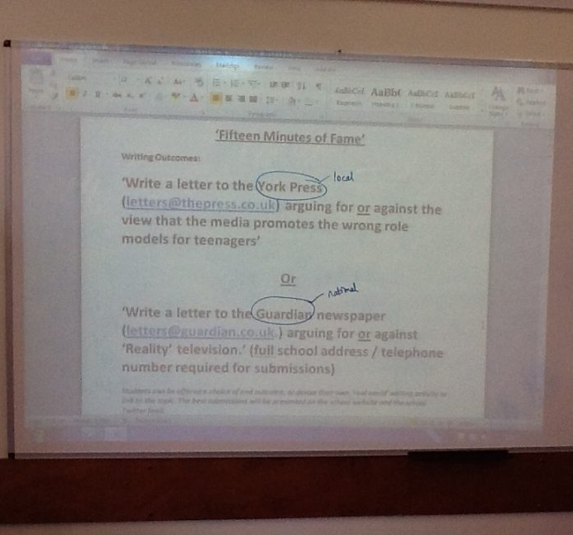
Scenario: Imagine you’re going to teach your first virtual small group this afternoon using Zoom.
1
2
3
Which of these classroom tools will you miss?
Notes:
Please place the heart. stamp ON the picture or pictures of tools that you will miss the most.
“Well, you don’t have to miss them anymore; Zoom and other tools offer a similar experience in the remote learning environment. We’ll show you how. Let’s get started!
Attributions:
Pixabay – whiteboard
Pixaby – paper/pen
annotation image:
https://www.theconfidentteacher.com/2012/11/making-the-learning-visible-using-multiple-whiteboards-in-the-classroom/

Slide 5
Objectives
Identify tools for annotating, whiteboarding, and collaborating virtually
Utilize screen space to effectively manage visual communication on one or more devices

Slide 6
Respond in Chat: What are some ways to communicate and collaborate with Zoom tools?

Slide 7
Overview of Zoom Communication Tools
Audio
Chat
Polls
Nonverbal “reactions”
Participant video
Shared content
desktop, apps, Zoom whiteboard, annotations
Notes:
All of these Zoom tools support communication and collaboration, including audio, chat, polls…Managing screen space for all the visual components is key or participants may risk missing communication Consider using certain tools at certain times…[talk more about these big collaboration ideas here]. Today, we’ll focus on the Participant Video and shared content.”

Slide 8
#1: Participant Video
Notes:
How can I best see people?
Let's start with participant video
- on/off as preferred, avoid requiring a participant to turn video on (humanizing)
- provide reasons that video on aids in communication
- direct participants to videos of interest

Slide 9
Participant Video
Zoom Release is currently 5.2.3!
See it: Spotlight
Host-controlled setting
Spotlight up to 9 videos
Speaker View
Try it: Pin Video
Participant-controlled setting
Pin up to 9 videos
“Unpin” to revert
Rearrange video order
Notes:
Activity:
Call in with stuffed animals on 2nd and 3rd devices
Attribution:
Freepik

Slide 10
Participant Video
Try it: Hide self and/or non-video participants
Participant-controlled setting
Alternative to “raising hands”
Gallery view
“Show non-video participants” to revert
See it & Try it: Adjust ratio of screen share to video
Only works in “Side-by-side” when at least one video is on and screen is shared
Gallery or speaker view
Can allow visibility of more video images!
Notes:
Activity:
Call in with stuffed animals.
Hide nonvideo participants

Slide 11
#2: Sharing Content
Notes:
“For the rest of this session, we’ll focus on shared content….”
Managing screen space for all the visual components is key or participants may risk missing communication. Consider using certain tools at certain times

Slide 12
Sharing Content
Application Windows
Desktop (All Apps)
Specific Apps
Annotations
Zoom Whiteboard
Advanced Options
Portion of screen
Music only
Notes:
Facilitator stops sharing and participants Click on shared screen to explore

Slide 13
Annotations work on any shared application or screen
I will open a browser window that contains an image.
To respond to the prompt, use the Arrow in the annotate tools.
Notes:
https://i.pinimg.com/originals/84/f7/dd/84f7dd5d038fbe4168d77aa95441f2fe.gif
Show names/Hide Names of Annotators

Slide 14
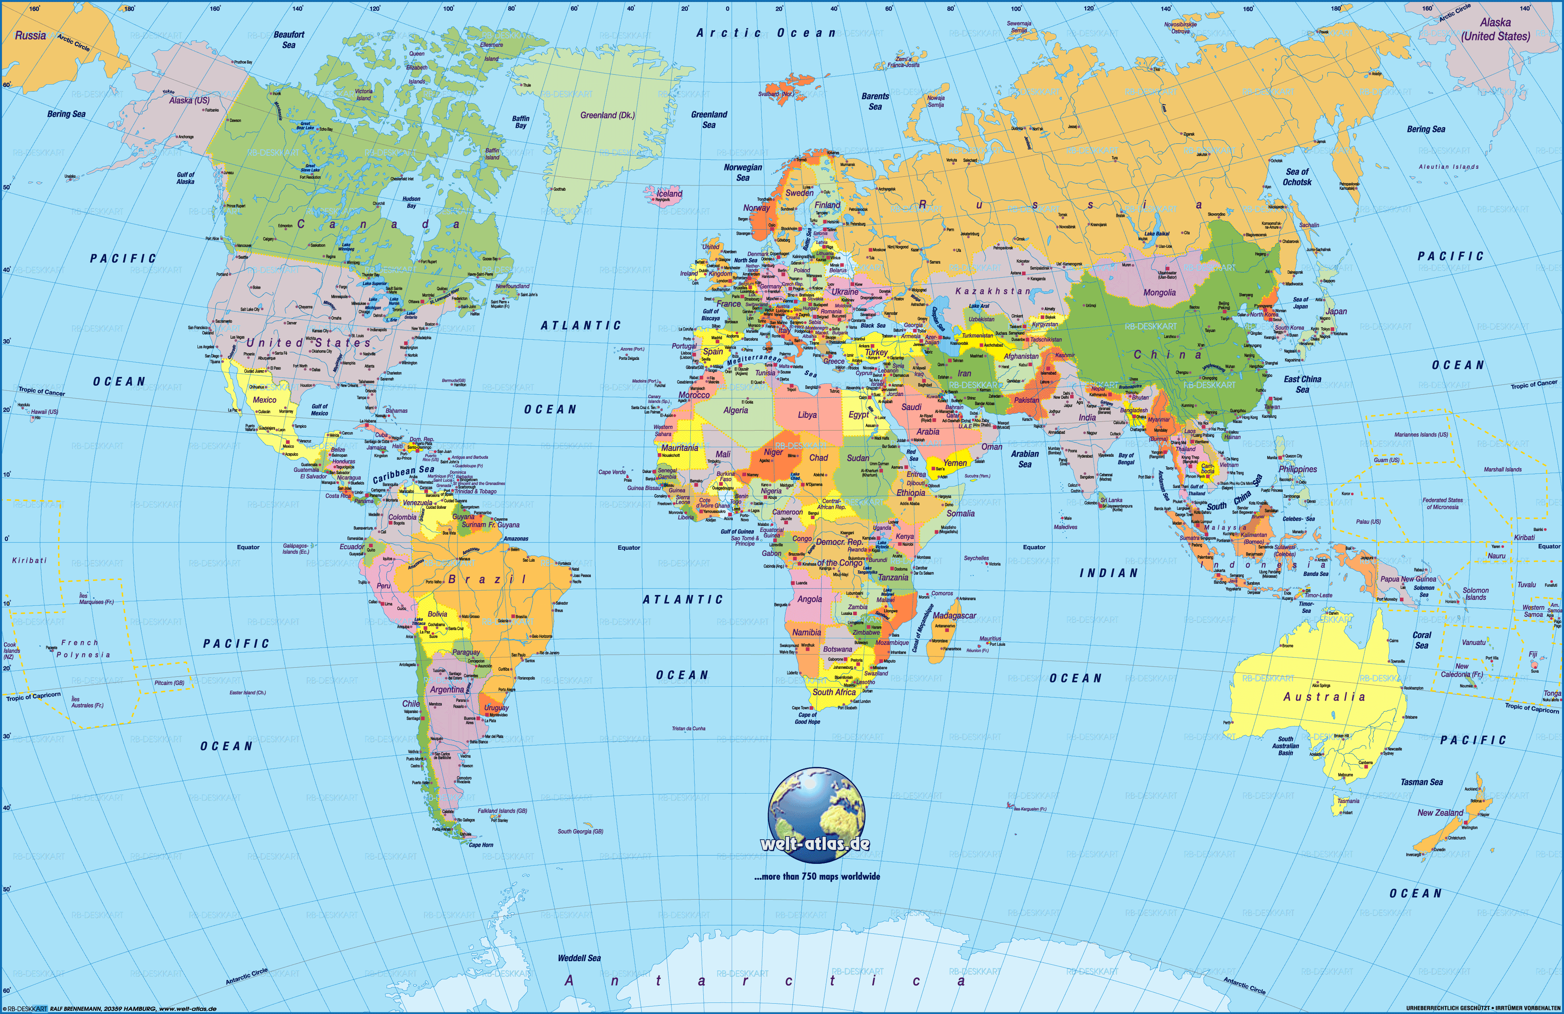
Notes:
Open the link in a browser: https://i.pinimg.com/originals/84/f7/dd/84f7dd5d038fbe4168d77aa95441f2fe.gif
Where would you like to travel once it is safe to do so?
Using the arrow function (show names of annotators)
Participants clear their own annotations

Slide 15
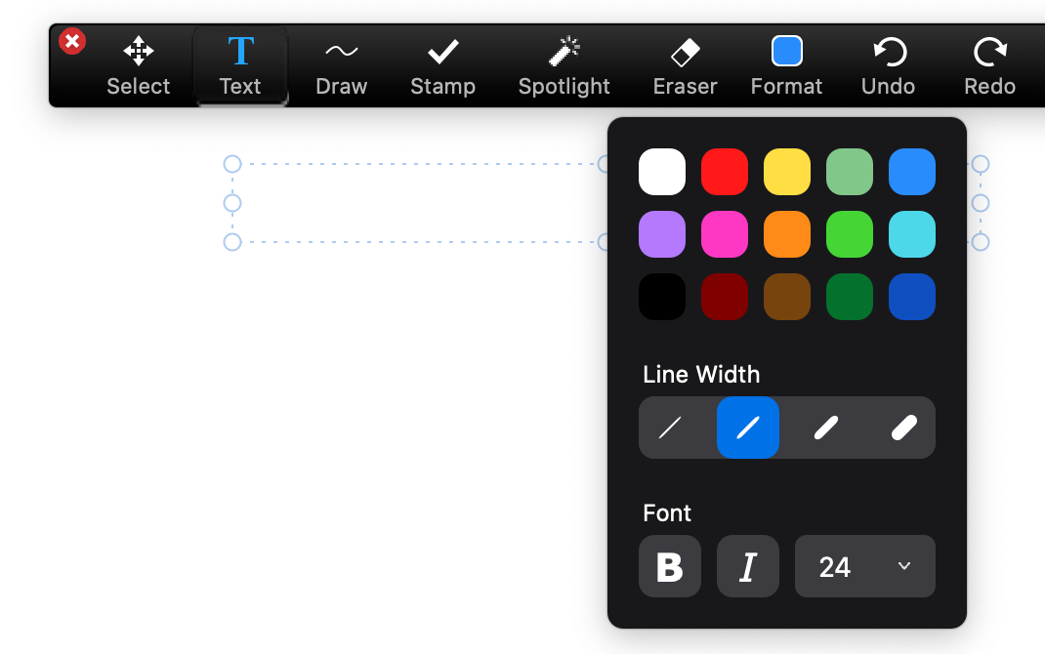
On the next slide, is a screenshot of PowerPoint being shared using Presenter View on the Facilitator's screen. The Facilitator is sharing a portion of the screen in Zoom.
Specific people will be asked to respond to a prompt through Text Annotations.

Slide 16
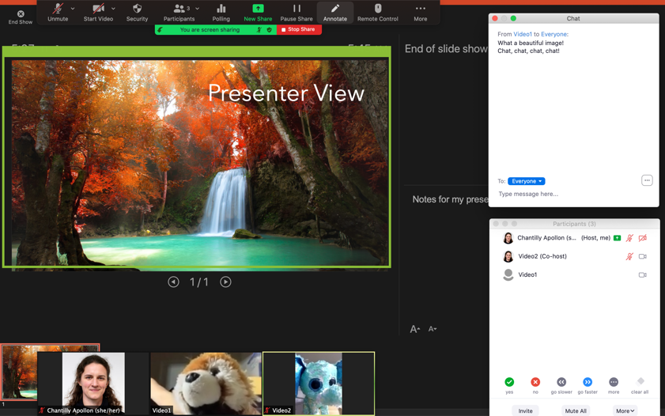
1
3
2
5
4
Notes:
Ask people to type a brief description for each arrow.
Consider asking them to change the color and or size of the font!

Slide 17
Zoom Whiteboard
Breakout Rooms 2-3 people
You can decide on a game
Option 1: Snowman
3-4 letter word
Formerly known as Hangman
Option 2: Tic-tac-toe

Slide 18
Whiteboarding & Annotating
Notes:
Use iPad for writing down these items:
JB: “What kind of experience did you have?”
Mouse versus stylus & touchscreen
Tablets
iPad & Apple Pen ($$$$$)
Kindle ($$)
Graphics Tablets ($)
Paper & Pencil + 2nd device camera

Slide 19
Whiteboarding & Annotating
Mouse vs. stylus & touchscreen
Tablets
iPad & Apple Pen ($$$$$)
Kindle ($$)
Graphics Tablets ($)
Paper & Pencil + 2nd device camera
Notes:
Use iPad for writing down these items
Mouse versus stylus & touchscreen
Tablets
iPad & Apple Pen ($$$$$)
Kindle ($$)
Graphics Tablets ($)
Paper & Pencil + 2nd device camera

Slide 20
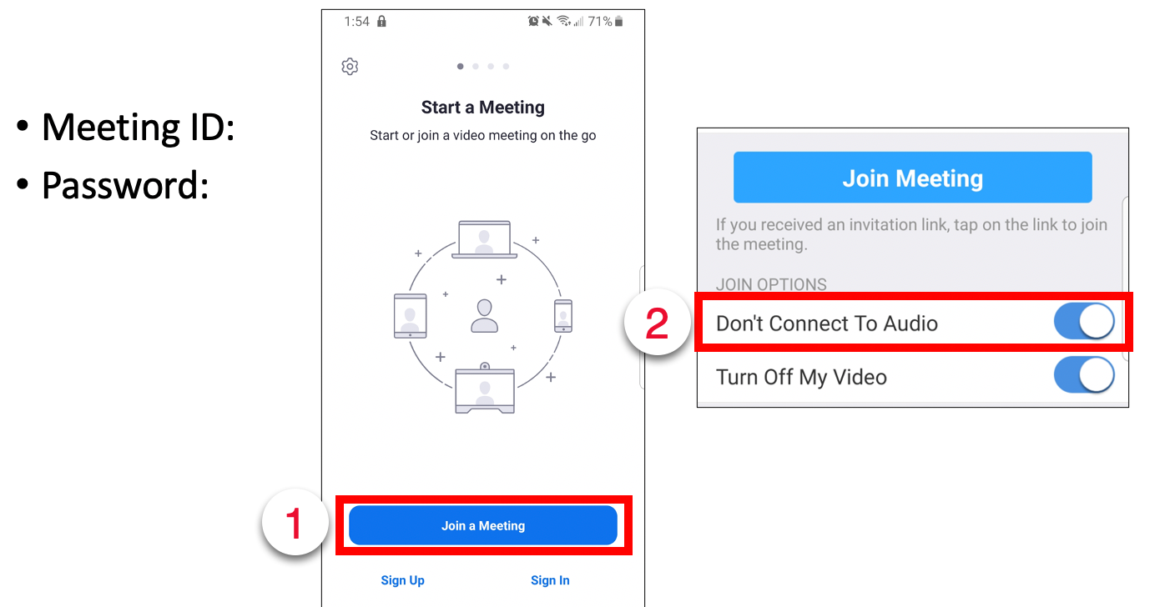
Second Device
Notes:
Attribution: Pixabay
2nd device offers
screen space
Touch screen capability
2nd video to point at another "subject"

Slide 21
Notes:
What is happening here?

Slide 22
Demo: Paper and Pencil
Notes:
Attribution: Freepik
Cannot annotate on a video!
Spotlight helps!

Slide 23
Cloud Collaboration | OneNote
OneNote Notebooks can include
Text
Drawings (Whiteboard or Shapes)
Images
Multiple Sections & Pages
UCSF supported & Secure
Can be shared to individuals outside of UCSF
Enter individuals’ email addresses
Notification sent to their email (check SPAM)
Enter a code to access document
Notes:
“Now we’ll take a look at a cloud-based collaborative tool that UCSF has vetted….”
Go to browser and show where to access OneNote
“Let us know in the feedback survey if you’re interested in exploring Cloud collaborative tools more deeply.”

Slide 24
OneNote Sample
Section 1: Journal Article Analysis
Each page is a figure
Section 2: Anatomy Images
Each page is an image
Section 3: Case Studies
Each page is a case
Section 4: Discussion Questions
Each page has the same questions that can be assigned to separate Breakout Rooms
Section 5: Sandbox
Feel free to play around/make additional pages
Notes:
Set up an example for people at UCSF
https://ucsfonline-my.sharepoint.com/:o:/g/personal/chantilly_apollon_ucsf_edu/EnF56Whk-0NCiHxIaPOY1ocBpU9IRDnrcuFEPpEtX9fsvw?e=Qw8uVu

Slide 25
What makes collaboration effective?
Establish an environment of shared leadership and ownership
Roles and norms
Have a common goal
Instructions and motivation
Communicate effectively
Focus of this workshop
Value and celebrate work
Feedback
Notes:
All of these tools are just part of effective collaboration….

Slide 26
Here’s what we did today:
Explored tools for collaborating virtually that will require additional practice.
Utilized screen space to effectively manage visual communication on one or more devices.
Video settings, Annotating, Whiteboarding, Cloud tools
As a facilitator, include instructions for what tool(s) to use and how to use it.
We value your feedback!
Link in chat to survey. Let us know if you are interested in exploring Cloud tools further.
Notes:
https://ucsf.co1.qualtrics.com/jfe/form/SV_0kzKE5IJSl8VyOF
https://meded.ucsf.edu/remote_learning

